Slide 1
COAT OF ARMS
DUE: AUGUST 30

Slide 2
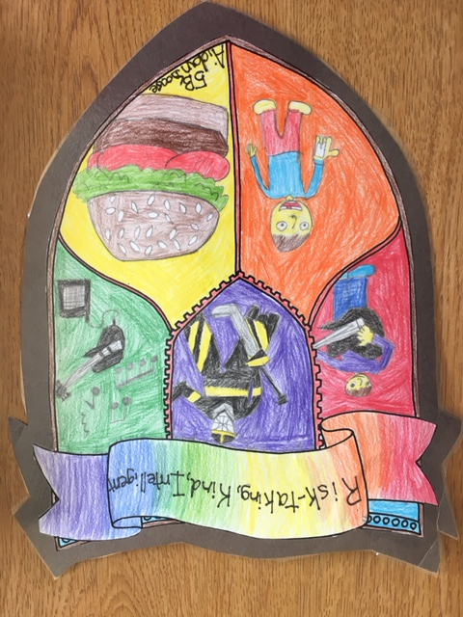

Slide 3
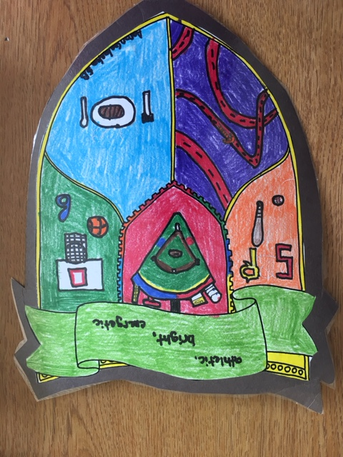

Slide 5
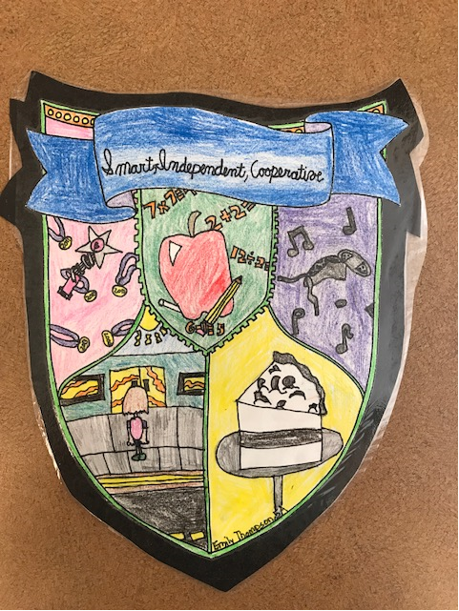

Slide 6
